Slide 1
FIT5147 Data Exploration and visualisation TP2 2017
Assessment 1 | DataVis Design Exercise
Alen Bednjacic abed10@student.monash.edu Student ID: 10528199 19 March 2017 | Aruna Tillekeratne taru3@student.monash.edu Student ID: 19 March 2017

Slide 2
Brief
Design visualisations to help understand a data set collected by sociologists who are comparing the rates of different types of crimes (i.e., personal crimes and property crimes) in different Victoria suburbs, and exploring how population density, mobility (by looking at the percentage of renting) and the demographic composition (including income, years of education, age composition) affect these.
The collected data set consists of one record for each suburb in Victoria. Each record gives the following suburb profile:
Suburb name: name of the suburb
Postcode & Geolocation: Spatial information about the suburb
Population: Number of residents in the suburb
Area: the area (in square meters) of land in the suburb
Percentage of renting: The percentage of household who are renting in the suburb
Age composition: The percentages of different age groups, e.g., age year 60+, age year 19 - 60, age year 0-19.
Avg. household Income: Average household income in the suburb
Avg. years of education: Average years of education of adult residents in the suburb
Crimes: Besides, each suburb record contains the number of reported personal crimes and property crimes occurred in the suburbs. By personal crime, we refer to “offenses against person/people, e.g., murder, sexual assault, etc.., and for property crime, we mean “offenses against property”: These are crimes that do not necessarily involve harm to another person, for example, Larceny.
This creation and presentation of this assignment follows the Five Design Sheet (FdS) methodology.

Slide 3
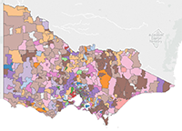
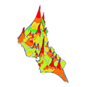
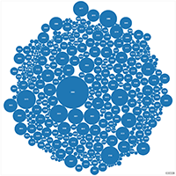

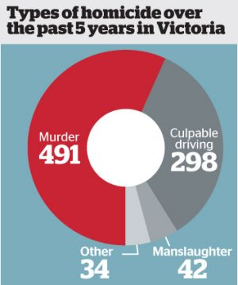
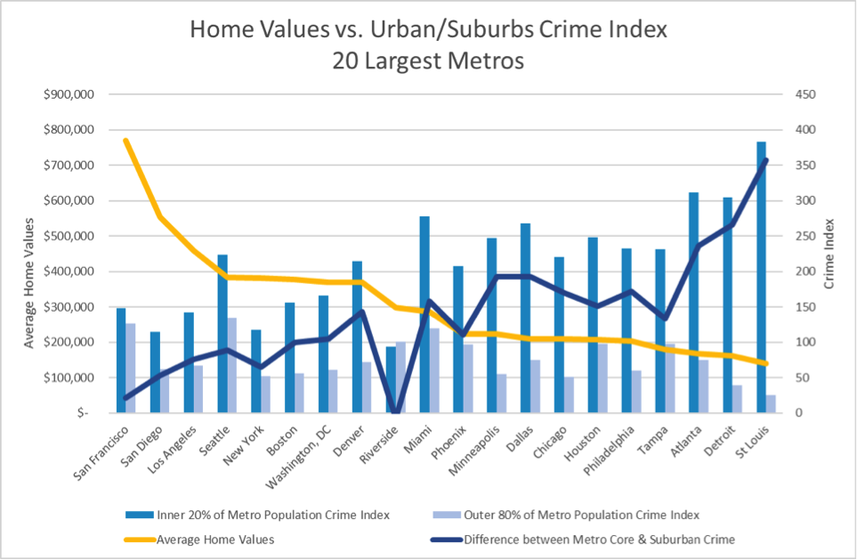
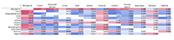
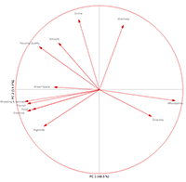
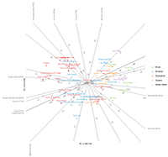
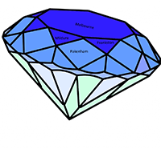
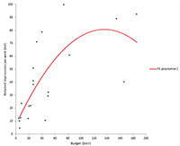
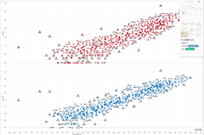
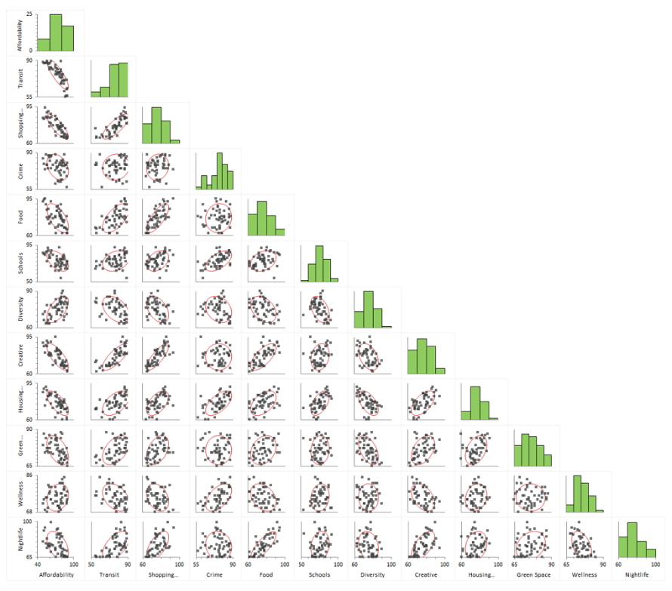
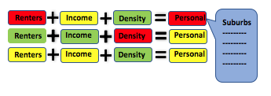
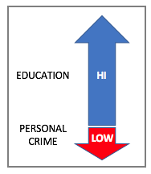
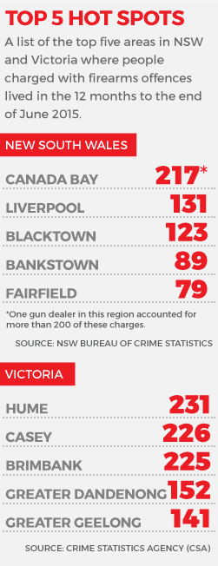
Sheet 1 – The Ideas Sheet
1. Ideas
2. Filter – remove duplicates and unrealistic ideas
1. Map View. | 2. Heat or Contour | 3. Bubble Chart | 4. Segments
5. Crime Radar | 6. Diamond – facets color adjacency and size used to convey data | 7. Evaluate Geo’ distance | 8. Multiple Axes
9. Histograms | 10. Scatter | 11. Correlation Matrix | 12. Outliers View
13. Colour mapped Tables / Pivot Tables | 14. Regression and other Models Plots | 15. Comparison tables | 16. Rank Top & Bottom N
17. Multiple Overlaid Charts | 18. Indicators – HIGH LOW | 19. Select variables | 20. Tabloid / Master Sheet
Remove:
2 Heat and Contour map – data hard to visualise, proximity doesn't correlated to crime levels.
Diamond – suitable for “property crime” less useful metaphor for personal crime
3. Categorise
Detailed Charts & Tables
Graphically abstract constructs
Multiple Axes or Composite
Charts
Q & A Controlled
Geo Data
Infolets / Rankings
4. Combine & Refine
C. Multiple Axes / Crime Radar
E. Statistician Mega Worksheet
A. Geographical Visualisation
DATA SUMMARY
------- -------- --- ------- -------
------- -------- --- ------- -------
------- -------- --- ------- -------
STATISTICAL ANALYSIS
MODEL ANALYSIS -----
5. Question
D. TABLOID
Do the designs solve the problem?
A = Yes, B = In a limited way as it limits the inputs, requires additional visualisations to give a complete view
C = Yes, D = In a limited way as it is made of of pre-determined infolets. Potentially with drill down into additional views it can be improved. E = Yes, but as it has ALL the plots and descriptions
Advantages / Disadvantages?
A – Geographical view provides additional useful information on how crime is distributed and concentrated.
B – advantage is that it provides a guided analysis based on user inputs
C – Visually appealing, may be difficult to create as it is a custom visualisation
D – Main purpose is to get attention and spark debate, useful for non-technical users. Disadvantage is that it is fixed purpose, data is abstracted to some extent
E – Too much detail only for the hard core data scientist who wants a one-sheet that describes the data in everv way possible, one chart at a time.
Designs chosen to proceed to detailed design phase:
A – Map Design, B – Construct a Query Design, C– Crime Radar Design.
B. Construct-a-
-Query Design
D. Tabloid
Top 10 Safest
Will you turn to crime?

Slide 4
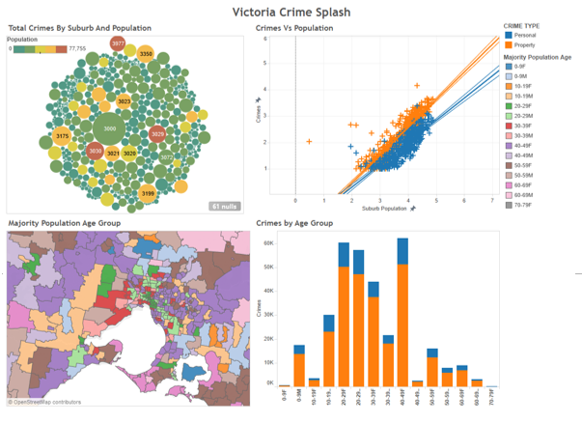
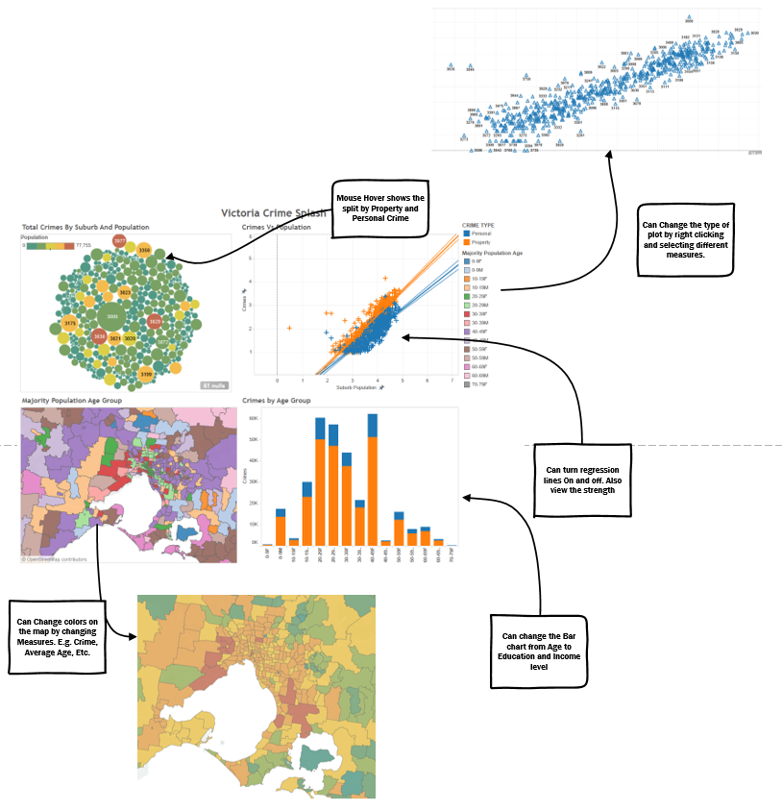
Sheet 2 – Geographical View
2. Layout
1. Information
Title: Geographical Crime Data Visualisation Tool
Author: Alen Bednjacic, Aruna Tillekeratne
Date: 19 March 2017
Sheet: Alternative Design Option
Task: Display Crime in Victoria in each suburb showing the influence of the data attributes around mobility, population density and demographics.
3. Operations
This visualization is delivered via web service.
Bubble chart and map will have mouse over modal which will show the split of the Property and Personal crimes in each suburb.
The user can select what to be shown in the Map and the bubble chart by right clicking on the chart and selecting a measure. The measures will include, population, Crime, average age, average income, etc.
Hovering over the scatter plot returns the values of each point.
Users can right click on the scatter plot to select measures to view correlations such as crime, population, income, etc.
4. Focus
5. Discussion
Advantages:
Single page apps are much smaller compared to multi page apps.
Users don’t need to traverse back and forth to look at data in different ways.
Plenty of interactivity is available and all operations are done with just the mouse.
Gives both info graphic style charts as well as statistical plots side by side to realize relationships.
Disadvantages:
Layout is relatively crowded and hard to change.
Users cant isolate graphs or information.
Page load will be slow since it’ll fetch data for all 4 containers and compute the view on all of them.
Feasibility:
Can be easily done with fast web frameworks such as Django, Razor, Rails, etc.
Visualisation libraries such as D3 and C3 allow easy interactive charts to be rendered on the client side without needing much back end work.

Slide 5
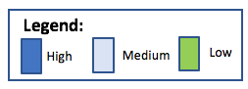
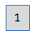
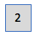
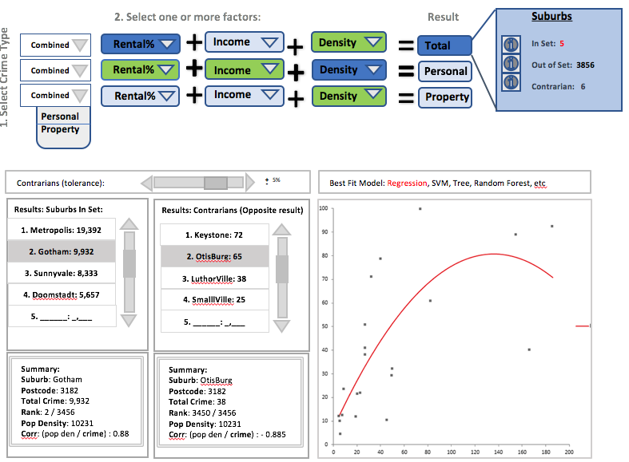
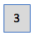
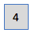
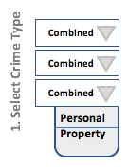
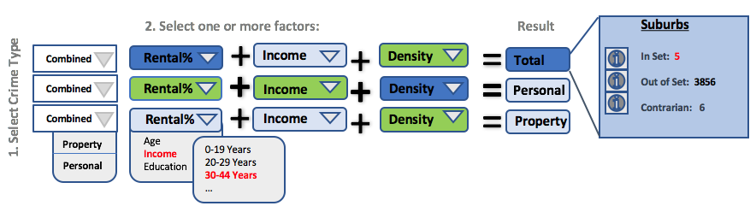
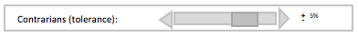
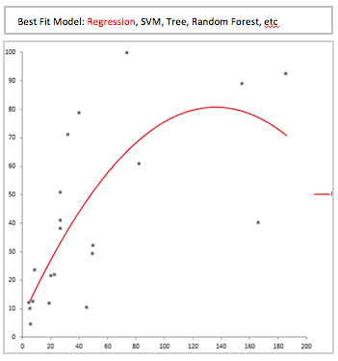
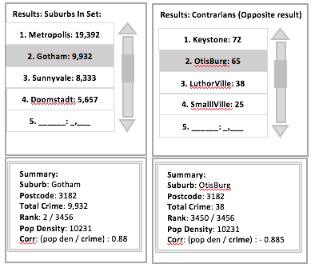
Sheet 3 – Construct-A-Query Visualisation
2. Layout
1. Information
Title: Construct-A-Query Crime Data Visualisation Tool
Author: Alen Bednjacic, Aruna Tillekeratne
Date: 19 March 2017
Sheet: Alternative Design Option
Task: Display Crime in Victoria in each suburb showing the influence of the data attributes around mobility, population density and demographics.
3. Operations
This visualisation must be driven interactively.
For each row, select if you would like the results for combined (total) of property and personal crime.
Select one or more factors/attributes , to answer your question, i.e. ”what is the total crime rate per 100,000 in a given rental %, with a given income band and population density band”.
Visualisation shows “contrarian suburbs who match criteria but have opposite to the common expected result. You can set a “tolerance” % band to catch or refine.
Select particular suburbs to see specific data otherwise summary shows stats for the group in the result set.
4. Focus
5. Discussion
For each query row you use, select via pulldown menu - Total Crime #, Personal # or Property Crime # to display
Advantages:
Interactive rather than static
This visualisation construct will specifically ”answer” queries about the observed crime rate, i.e. it supports a measure of “what if” analysis.
Displays detail data
Displays one or more predictive models and summary statics that are useful to the socialogist, i.e. gives them “data scientist” capabilities they can use very quickly.
Disadvantages:
Limited set of queries allowed
Whilst giving the ability to view all data, the summary and list panels are quite simple and don’t convey any data visually themselves.
Feasibility:
Query by example is supported in some query tools, but this is more of a composite dashboard of linked charts and requires embedding of a data modeling tool or this would need to a composite view created out of different tools and potentially code such as R, Python or J-Script.
For each query row you use, select one or more factors from the pulldown menu. Visualisation could have one or more rows.
Result Predicted
Select from all attributes
Total suburbs found
In Set – those matching criteria but give the predicted result
Out of set – those who don’t match
Contrarian - those matching criteria but give the opposite of the predicted result
Use slider or type # to set tolerance in % against the opposite correlation found
View the suburbs found in the selected result set, including those with the same factors but “opposite” result in terms of crime rate.
Display a plot of the model used for prediction. Potentially allow the user to select different models interactively to test results and chose more appropriate model.

Slide 6
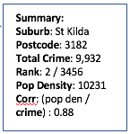
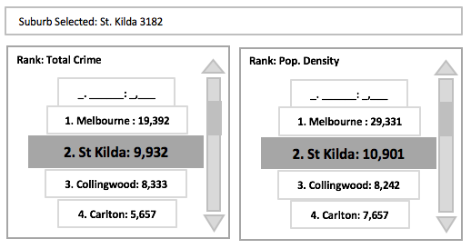
Sheet 4 – Crime Radar
2. Layout
1. Information
Select:
Pop. Density
Title: Crime Radar
Author: Alen Bednjacic
Date: 19 March 2017
Sheet: Alternative Design Option
Task: Display Crime in Victoria in each suburb showing the influence of the data attributes around mobility, population density and demographics.
Total Crime
X
_
Personal
Area Km²
St Kilda
_
Property
⬁
3. Operations
Select total of all crime, or just property or personal related crimes
Size of bubble shows relative size of attribute value (this may need some testing, as it might not scale well, an alternative is to use points and use the axis as a scale).
Select an axis or section of the radar to swap the data displayed in the Summary display panel based on what is selected (axis, section, suburb). It might be possible to allow selection of multiple suburbs.
Selecting anything focuses the rankings panels on either to top n, or if one suburb selected it shows its rank, if multiple suburbs are selected, then the rank scrolling device shows those suburbs specifically and not non-selected suburbs
Selecting a suburb (or perhaps double clicking it shows where that suburb is in each other axis, so the user can select those easily and so change the data displayed in the panels and attributes ranked.
Animate the visualisation so it “sweeps” around the axes, highlighting outliers or the selected suburb.
Avg
Years
Education
Population
2
Avg
Household
Income
Renting %
1
Age Composition
3
4. Focus
1
Summary of data and statistics depending on what is selected (axis, section, suburb)
3
Selecting suburb shows same suburb for each attribute value in each axis as an overlay
Summary:
Suburb: St Kilda
Postcode: 3182
Total Crime: 9,932
Rank: 2 / 3456
Pop Density: 10231
Corr: (pop den / crime) : 0.88
5. Discussion
Advantages:
Innovative and eye-catching design can make this an effective presentation tool and also generate more interest in the topic compared to a boring, conservative or too-often seen representation.
Shows all attributes of the data in a single display, to quickly identify stand-out features
Could work nicely in 3D as well as 2D
Easy to extend by adding more analytical/data panels, selectors to reduce or concentrate on specific factors or ranges
Disadvantages:
Too busy with all suburbs in the state – may not scale well for other states
Might be difficult to find a suburb of interest – might need to add a suburb search or lookup
Is actually a little simplistic, with limited usefulness outside of its direct function, so may not meet all the future needs of a sociologist without significant modification or extension.
Might need a big display to make navigation and selection even possible.
Feasibility:
Not a standard chart type in the usual data visualisation products, so this needs to be custom coded, for example in Javascript/D3.
2
Ranking of suburb compared to crime, attribute selected
Suburb Selected: St. Kilda 3182
Rank: Total Crime
Rank: Pop. Density
_. ______: _,___
_. ______: _,___
1. Melbourne : 19,392
1. Melbourne : 29,331
2. St Kilda: 9,932
2. St Kilda: 10,901
3. Collingwood: 8,333
3. Collingwood: 8,242
4. Carlton: 5,657
4. Carlton: 7,657

Slide 7
Sheet 5 – Realisation
2. Layout
1. Information
Title: Crime Radar
Author: Alen Bednjacic
Date: 19 March 2017
Sheet: Alternative Design Option
Task: Display Crime in Victoria in each suburb showing the influence of the data attributes around mobility, population density and demographics.
3. Operations
4. Focus
5. Detail

Slide 8
References
Five Design Sheet methodology:
Jonathan C. Roberts, Chris Headleand, and Panagiotis D. Ritsos, “Sketching Designs Using the Five Design-Sheet Methodology,” Visualization and Computer Graphics, IEEE Transactions on , vol.PP, no.99, pp.1,1
http://fds.design
Text Books:
Visualisation Analysis and Design, Tamara Munzner, A K Peters/CRC Press 2014, eBook ISBN: 978-1-4665-0893-4, Chapters 1-3.
Crime Data and example visualisations:
https://www.crimestatistics.vic.gov.au
Other:
Various un-labled and un-cited stock art, images and visualisation found through internet searches.

